Slide 1
Contextformer Hallucination Investigation
Dong Zhang
CCRS Government of Canada
November 12, 2025

Slide 2
Methods & Summary
Eliminating hallucinations through retraining:
Retrained Contextformer 6M on the greenearthnet 34TET training region for 100 epochs
Generated predictions for minicube 225 of the ood-t chopped sites with the retrained model
The hallucination on MJJ21 timestep 10 is eliminated however it does not seem to be able to predict vegetation growth as can be seen in the overlapping MJJ21, JAS21, and SON21 predictions
Identifying hallucinations:
Separated previous MJJ21 ood-t predictions into single timestep GeoTIFF files to be viewed in File Explorer
63 hallucinations were identified in this way
For 10 hallucination sites, the MJJ hallucination and overlapping JAS predictions are shown

Slide 3
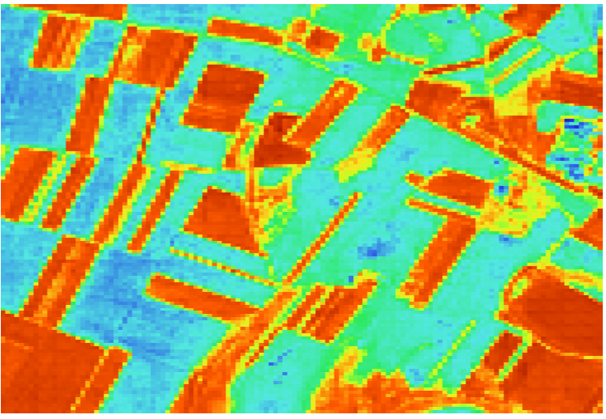
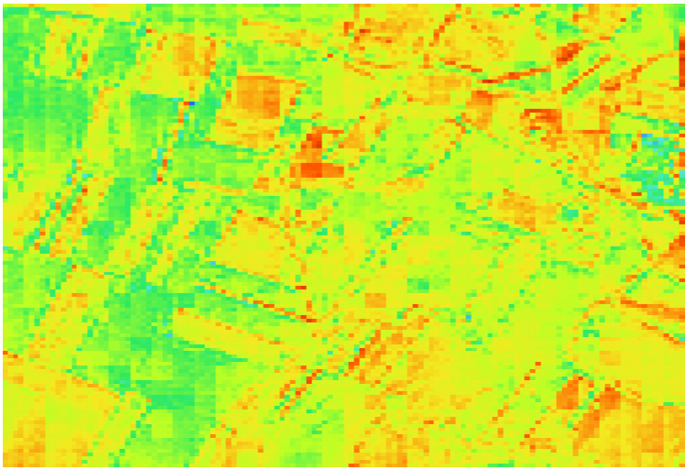
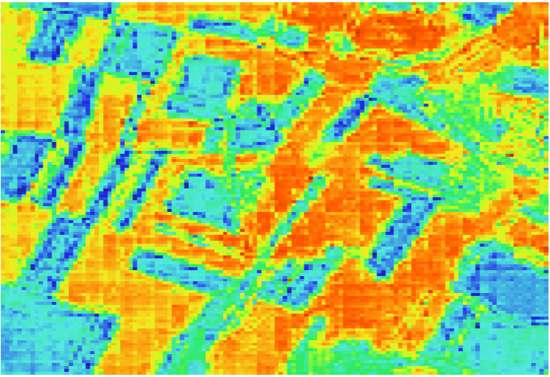
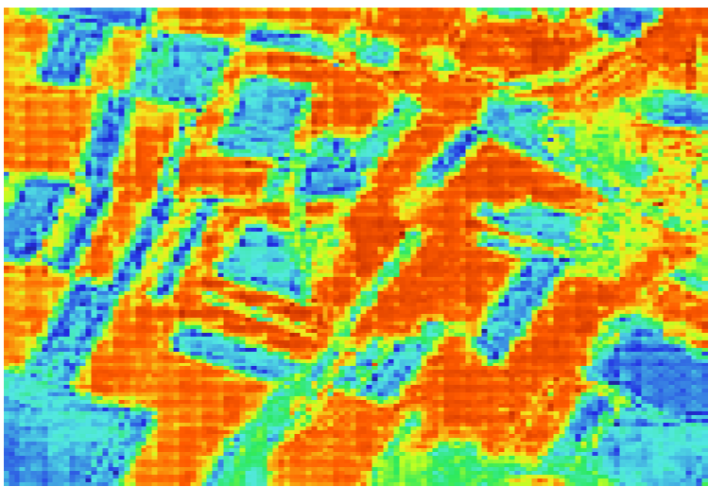
Original results (MJJ)
Timestep 5
Timestep 10
Timestep 15
Timestep 20

Slide 4
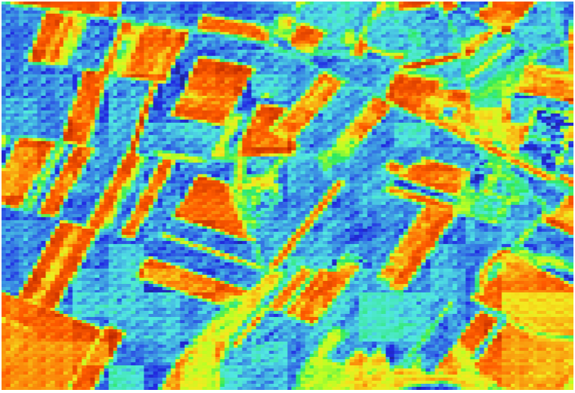
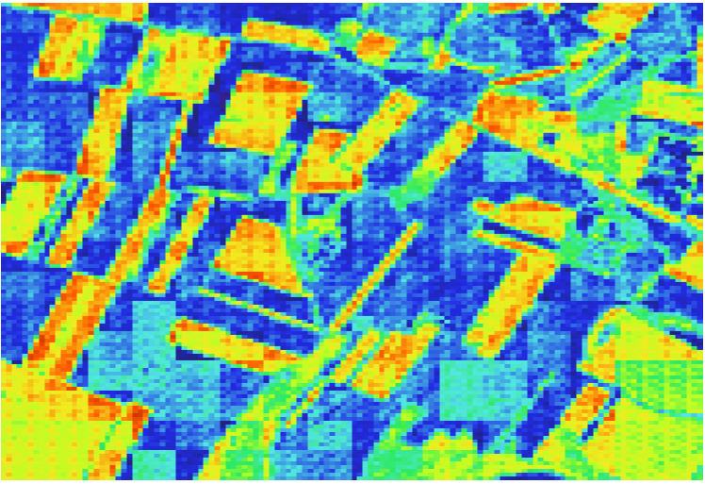
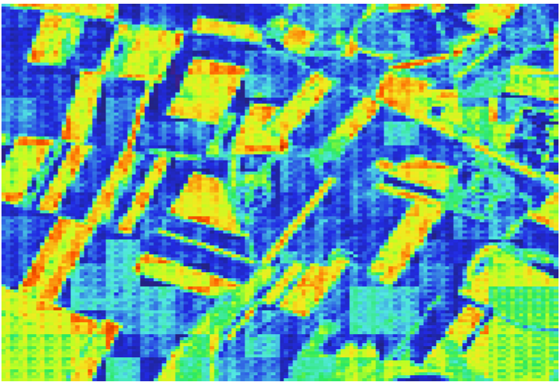
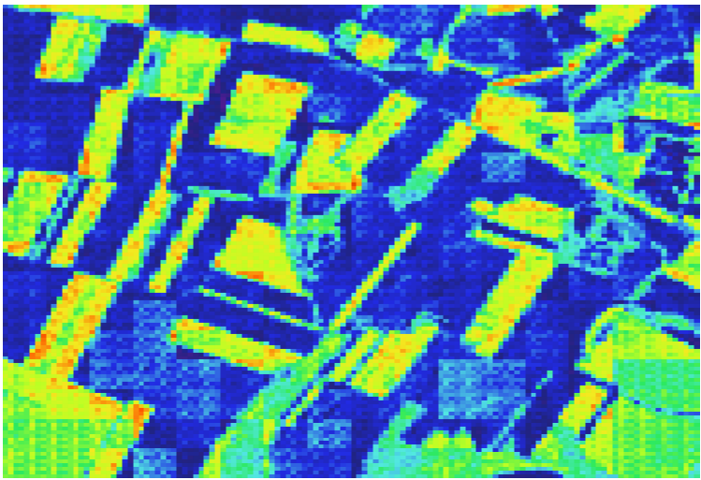
Retraining results (MJJ)
Timestep 5
Timestep 10
Timestep 15
Timestep 20

Slide 5
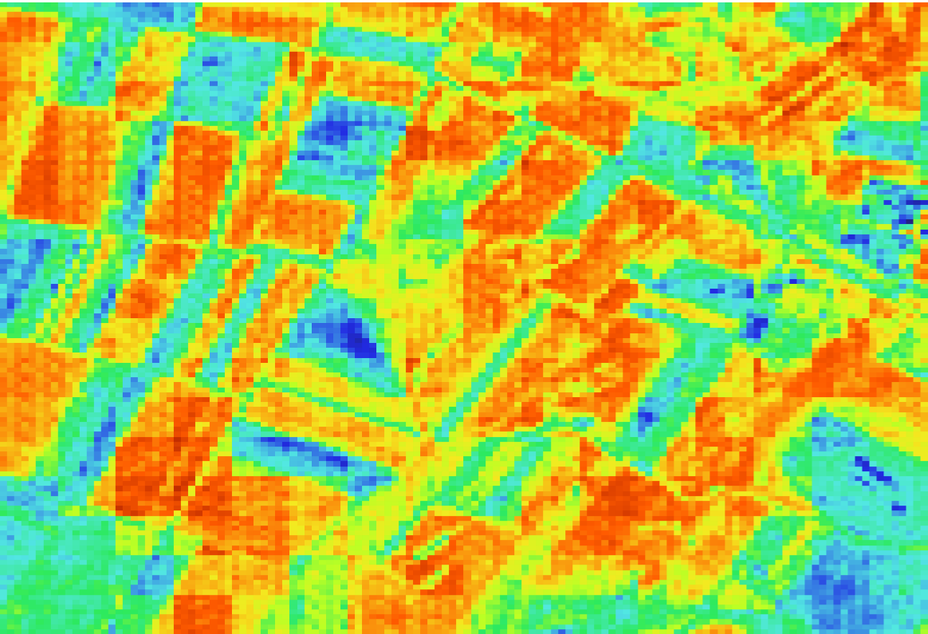
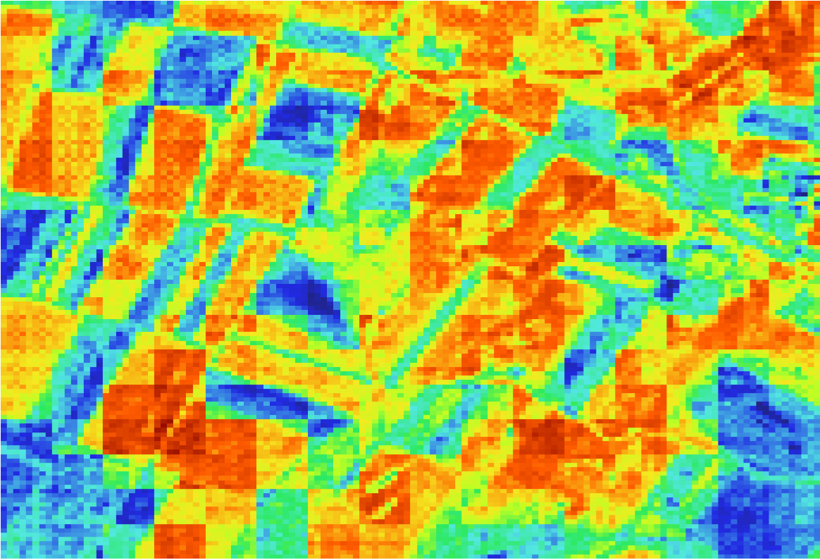
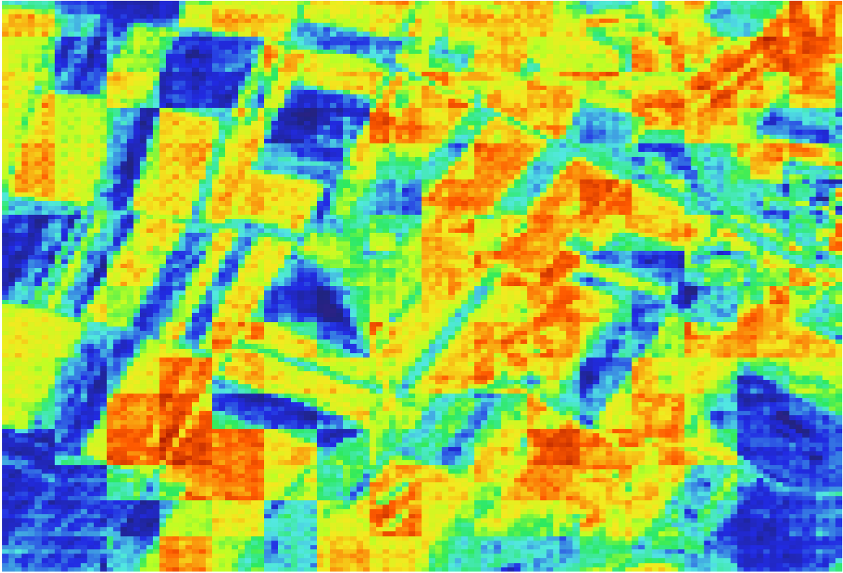
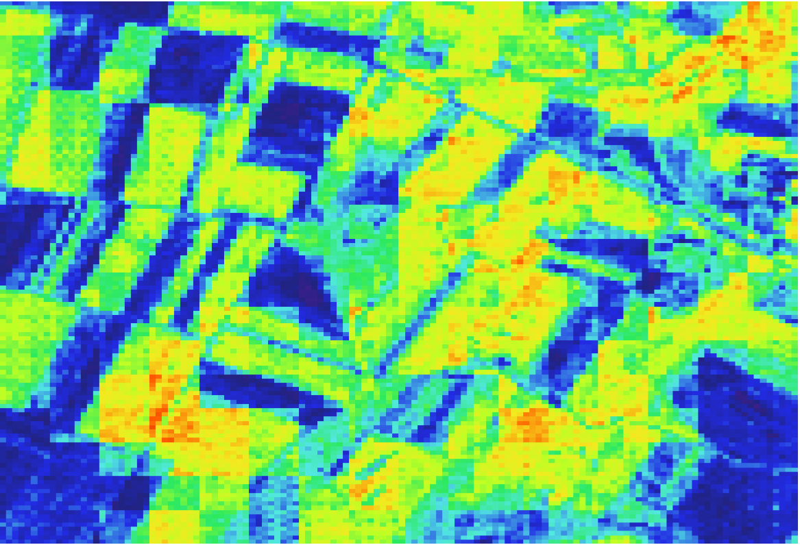
Retraining results (JAS)
Timestep 5
Timestep 10
Timestep 15
Timestep 20

Slide 6
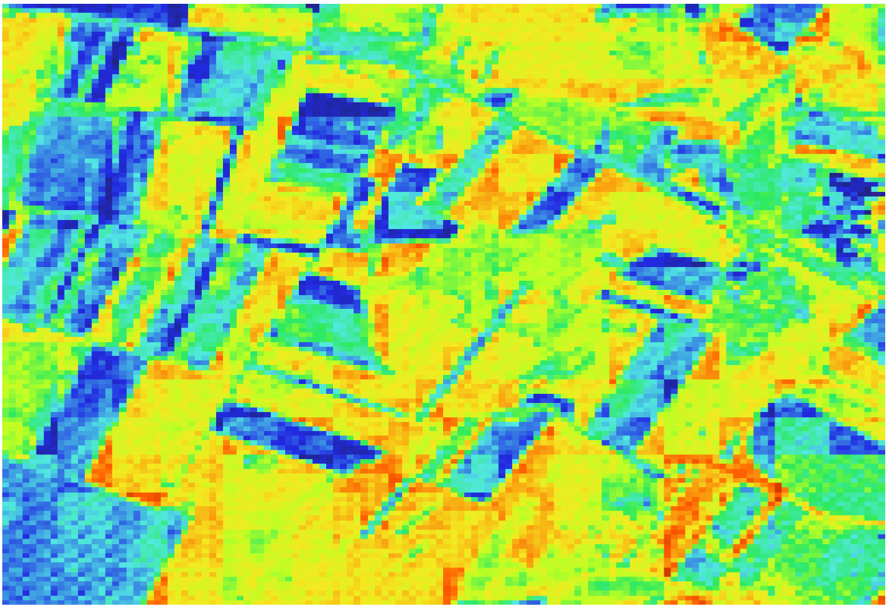
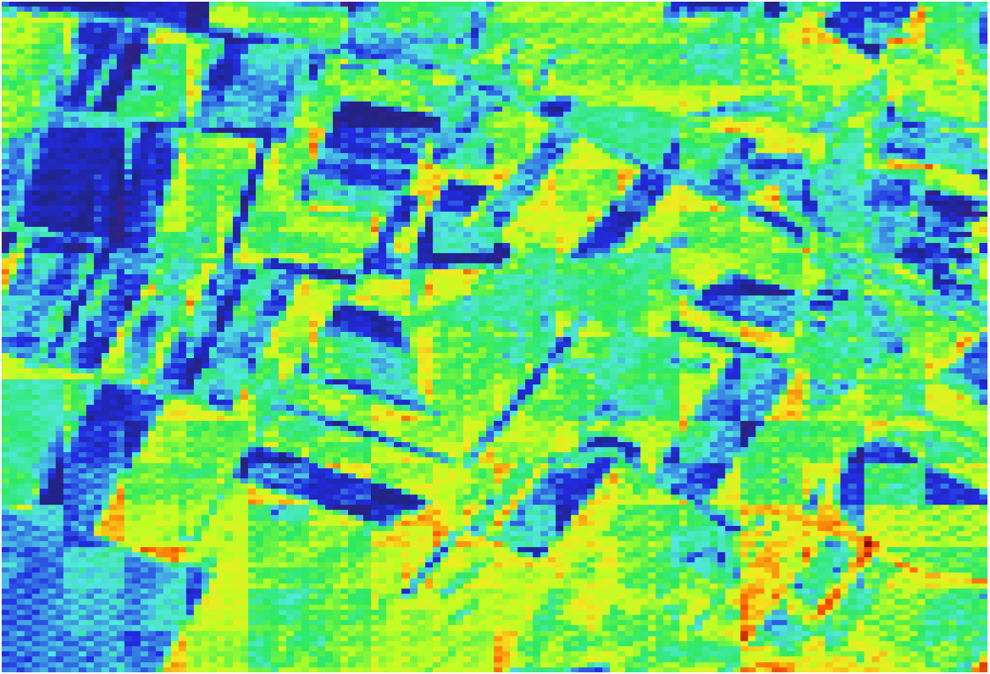
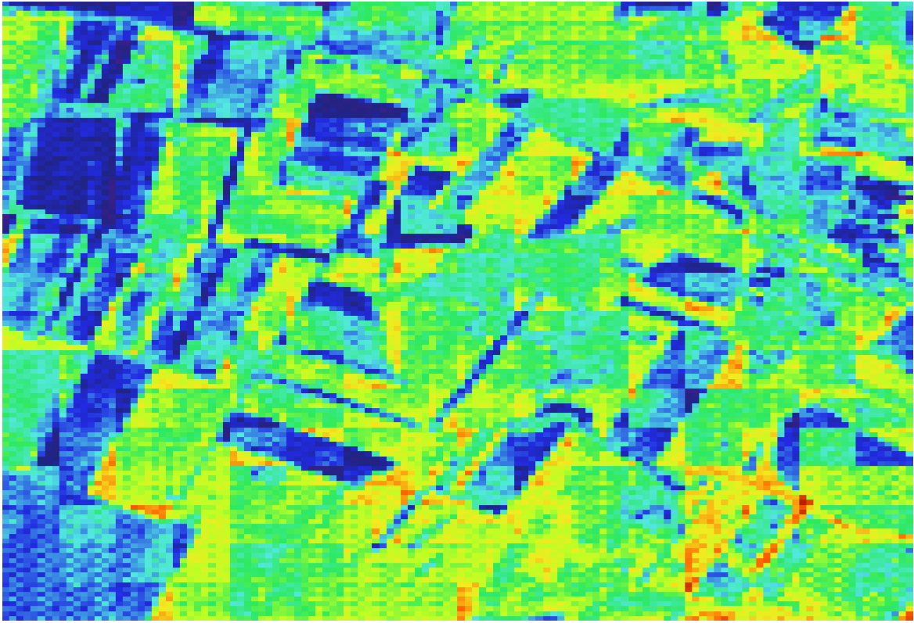
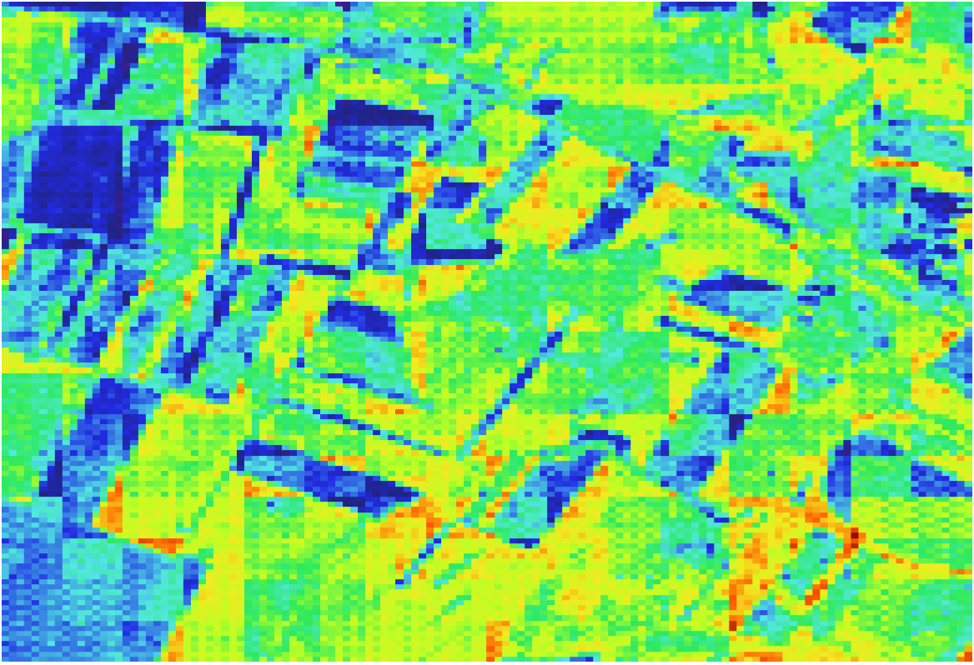
Retraining results (SON)
Timestep 5
Timestep 10
Timestep 15
Timestep 20

Slide 7
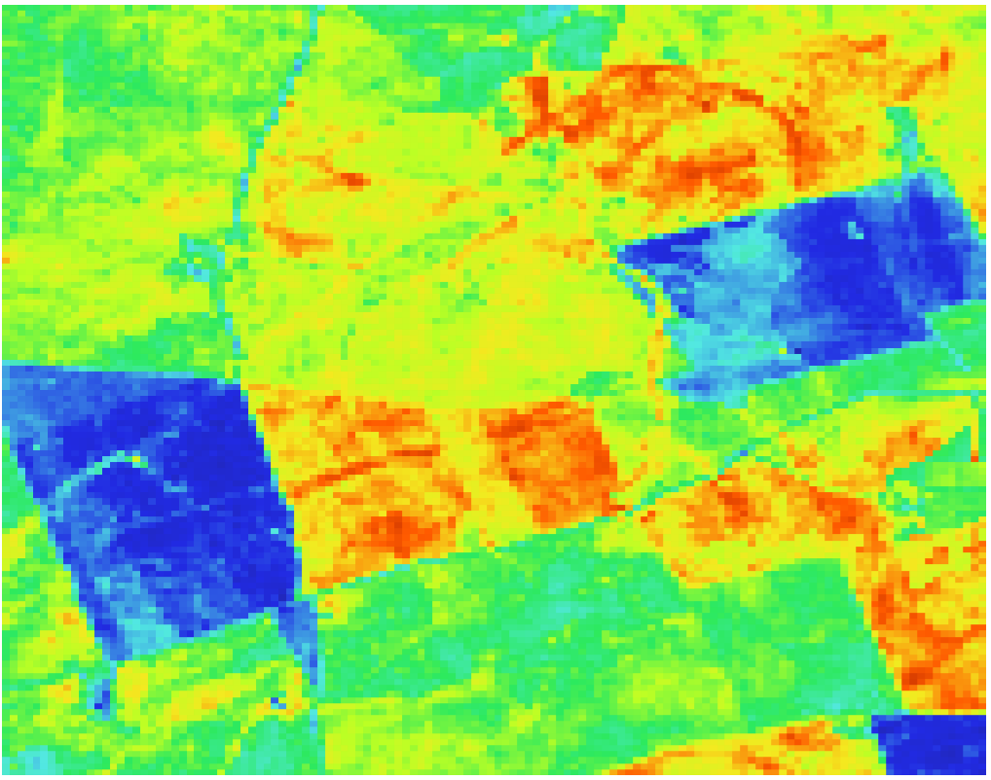
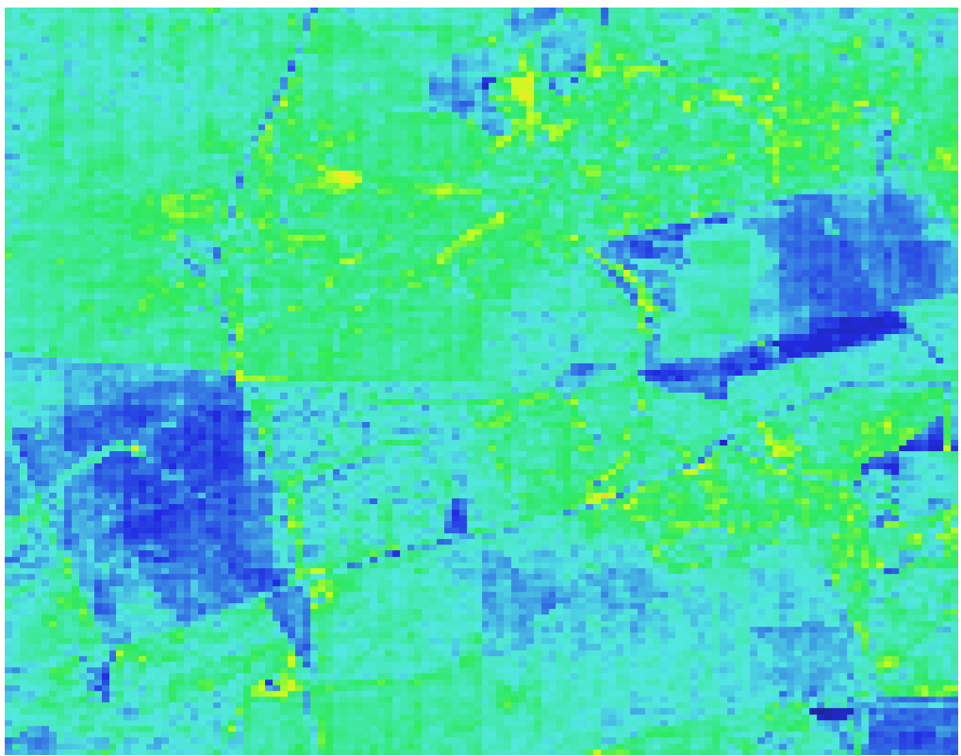
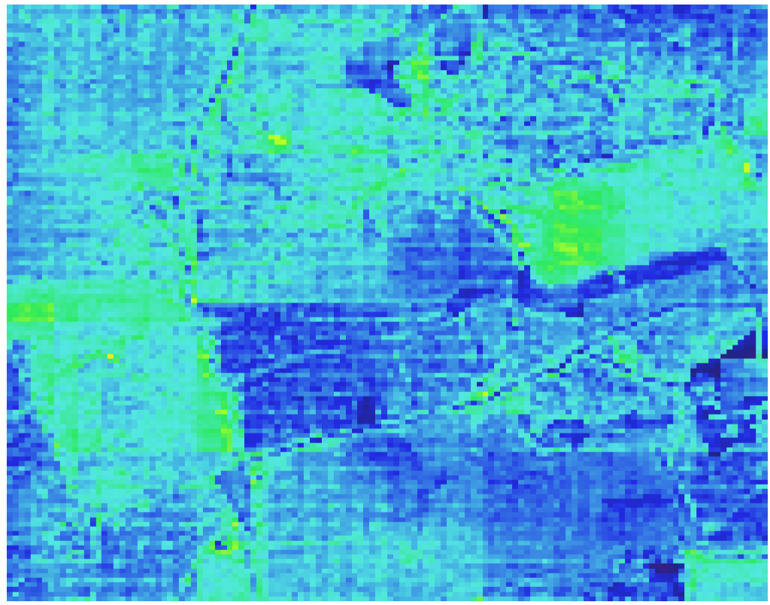
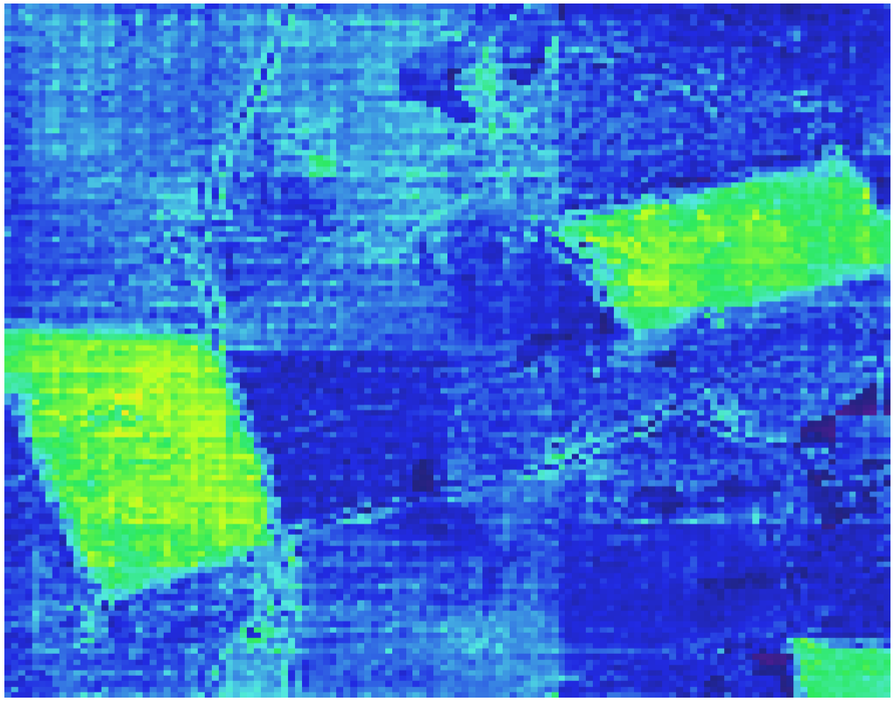
Site 22 MJJ21
Timestep 1
Timestep 5
Timestep 8
Timestep 15

Slide 8
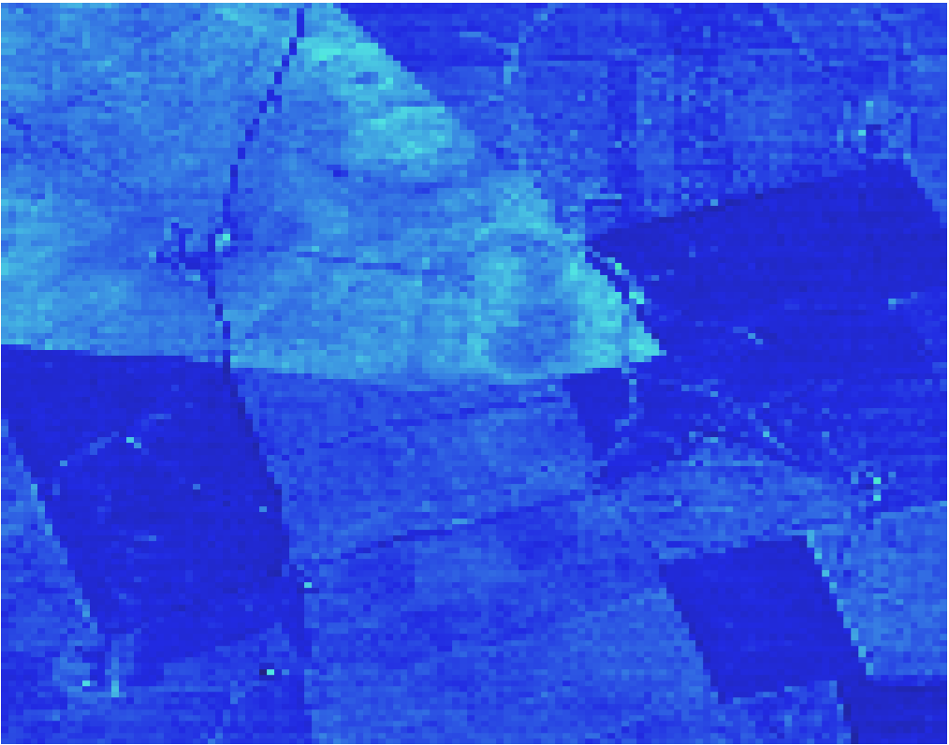
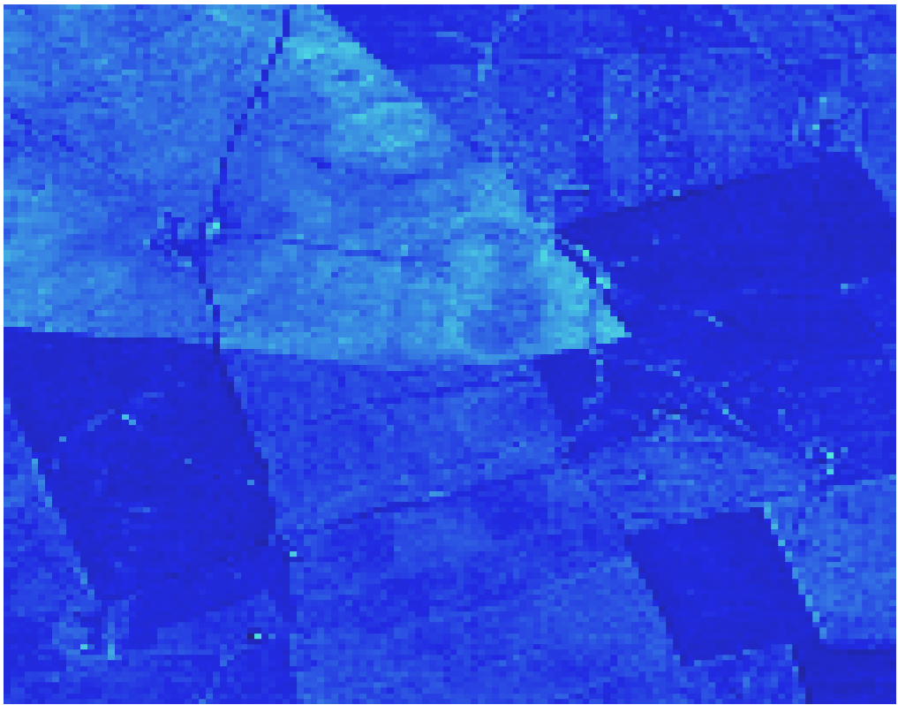
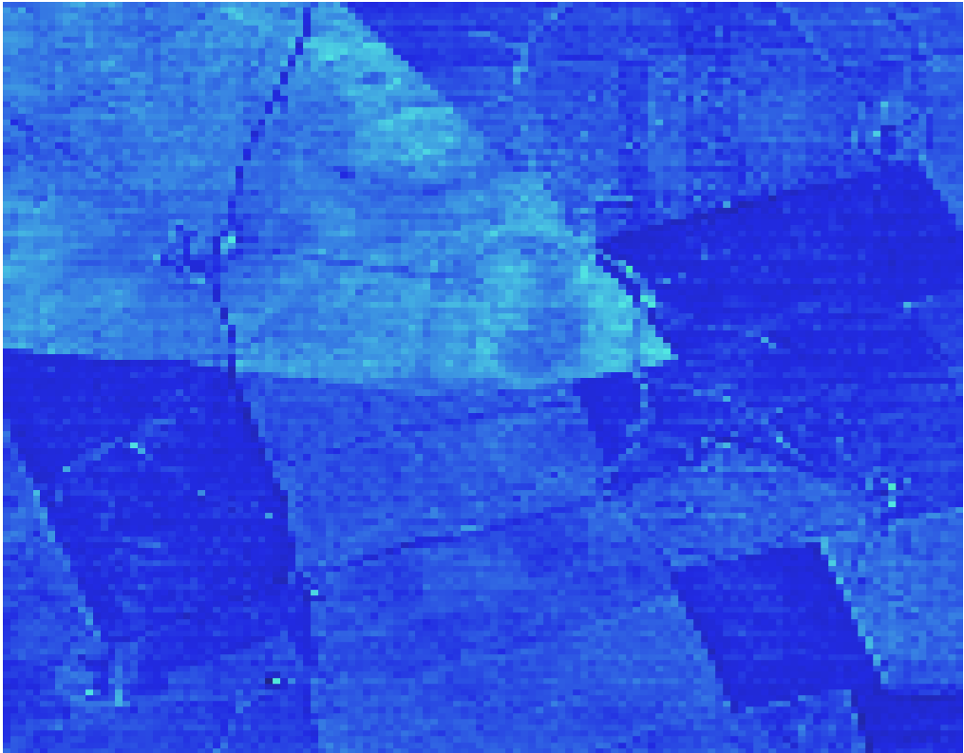
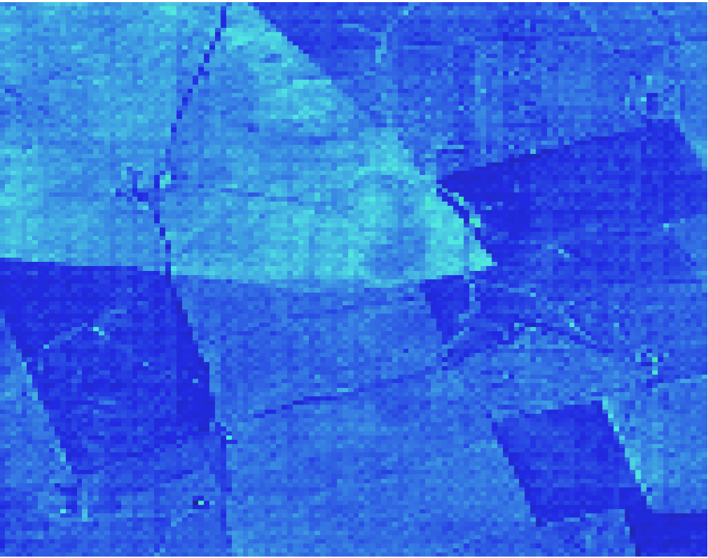
Site 22 JAS21
Timestep 5 (equivalent to MJJ21 Timestep 17)
Timestep 10
Timestep 15
Timestep 20

Slide 9
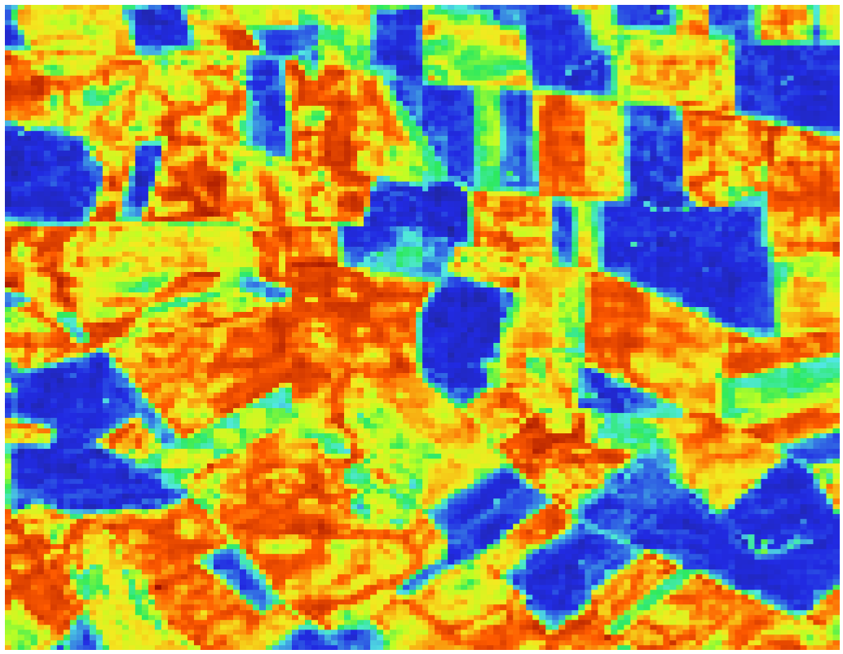
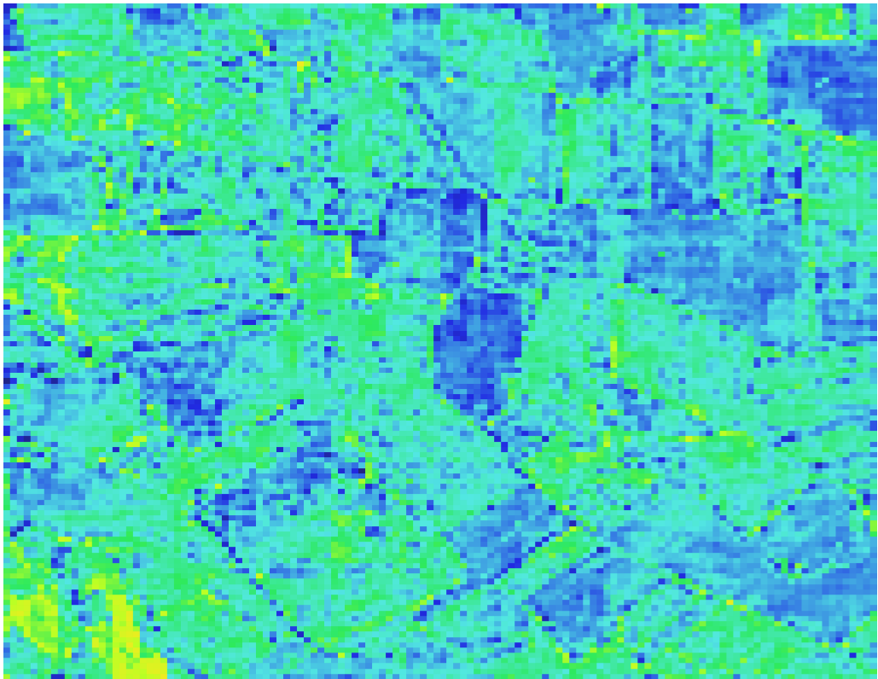
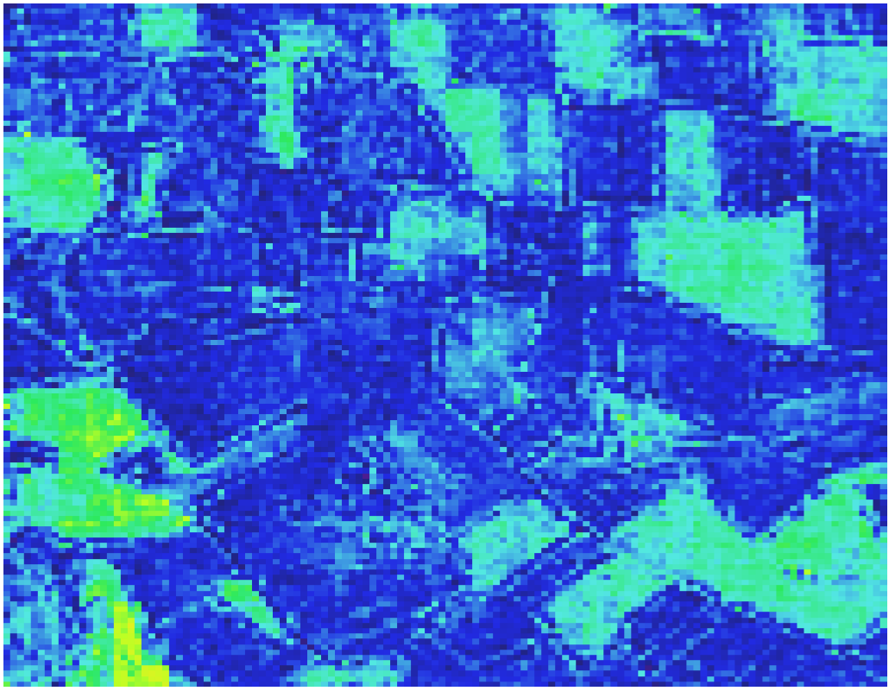
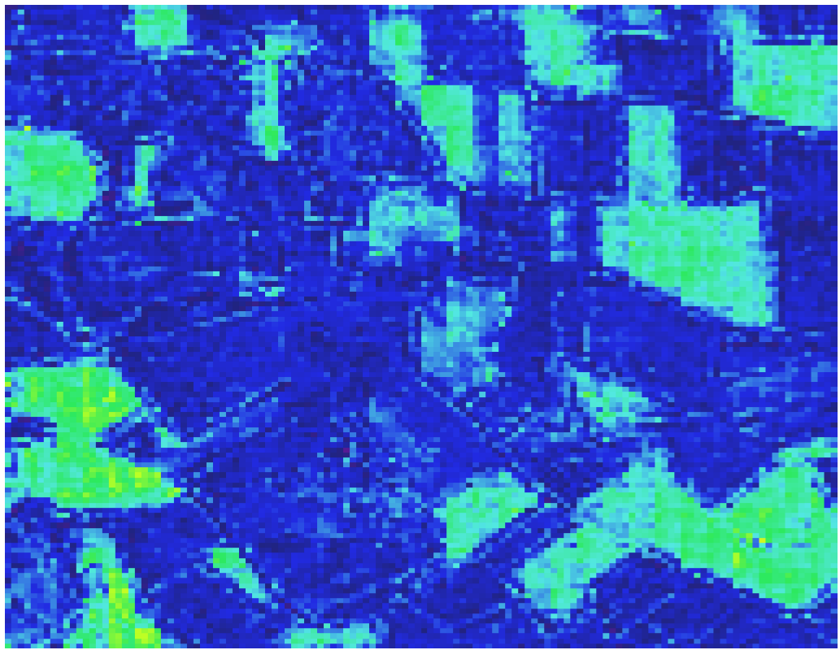
Site 27 MJJ21
Timestep 5
Timestep 10
Timestep 15
Timestep 20

Slide 10
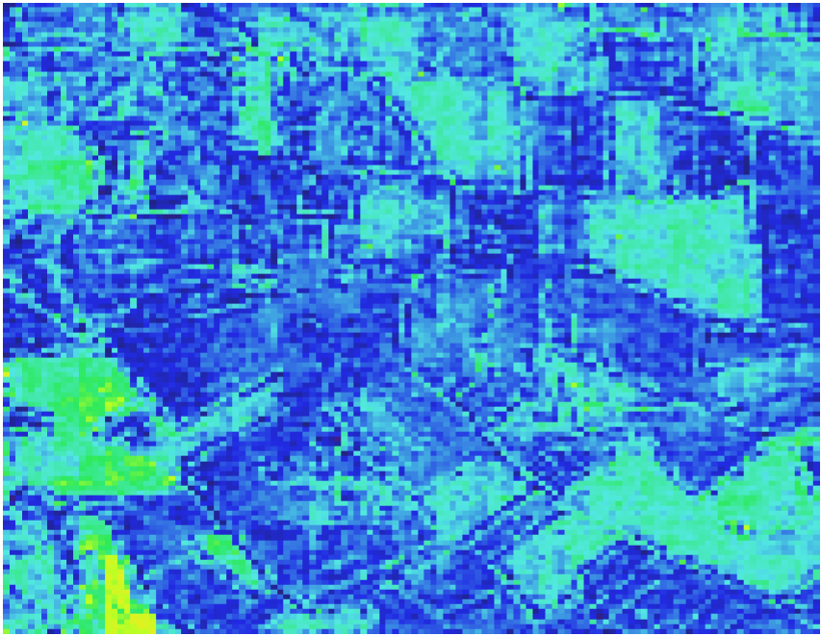
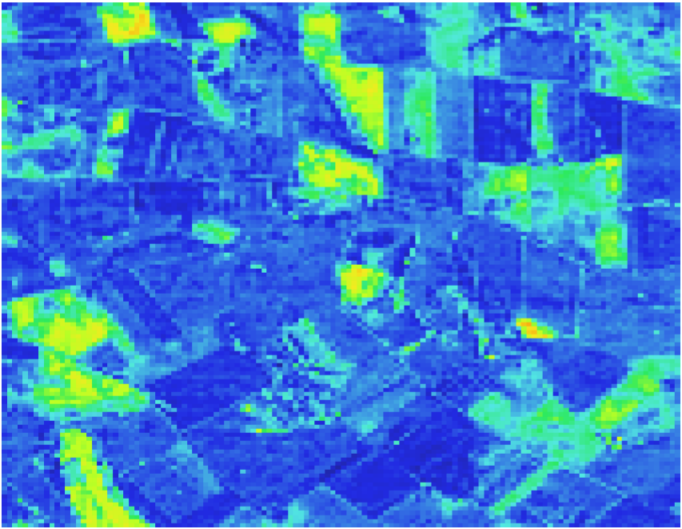
Site 27 Transition
MJJ21 Timestep 13 (equivalent to JAS21 Timestep 1)
MJJ21 Timestep 10
JAS21 Timestep 1

Slide 11
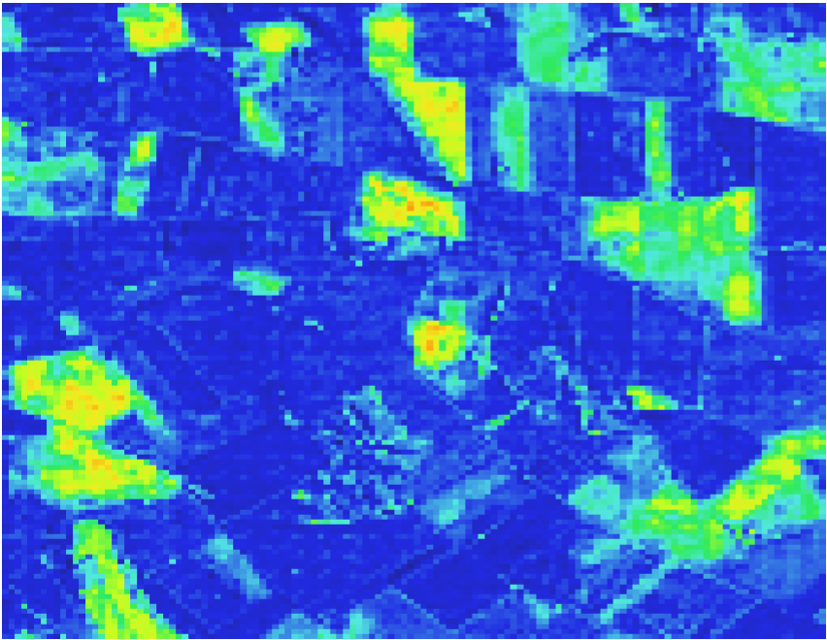
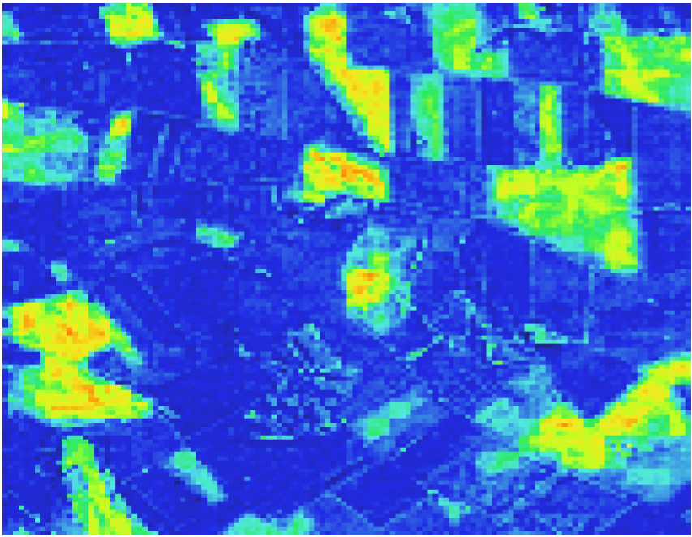
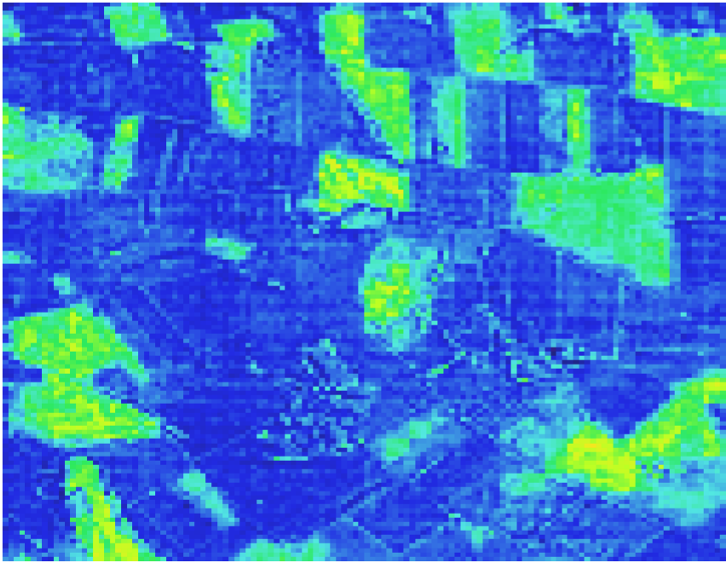
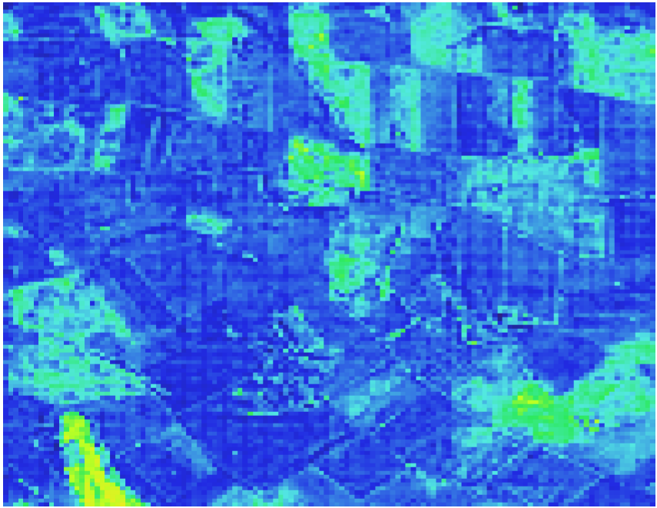
Site 27 JAS21
Timestep 3 (equivalent to MJJ21 Timestep 15)
Timestep 8
Timestep 13
Timestep 18

Slide 12
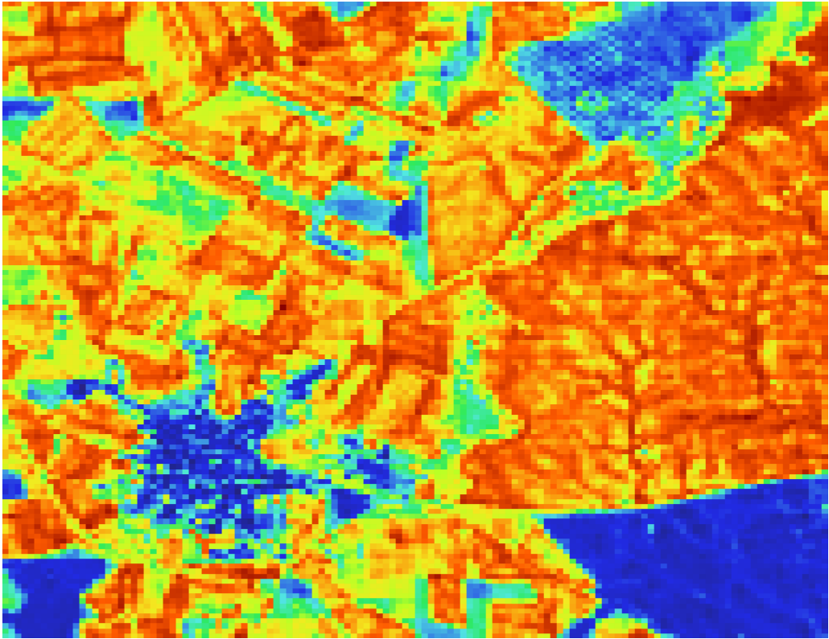
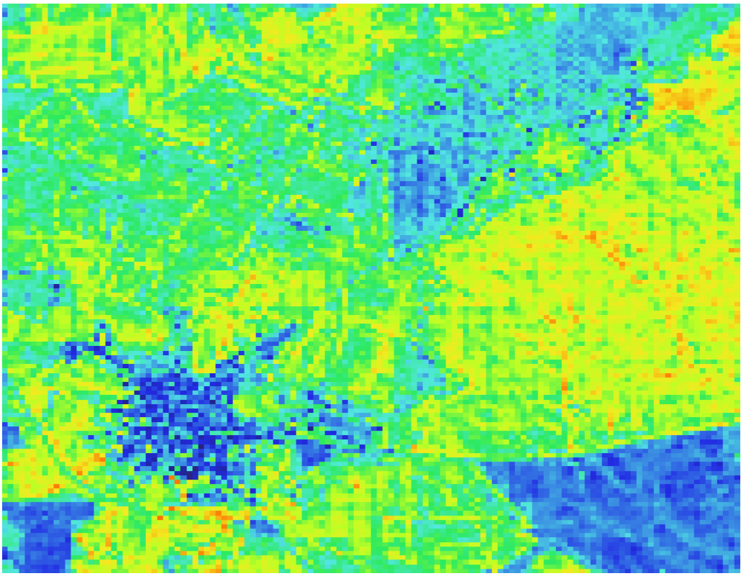
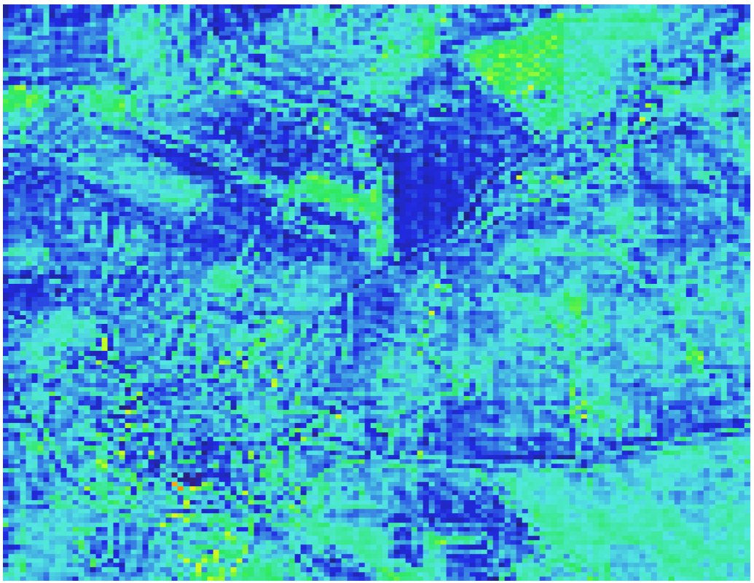
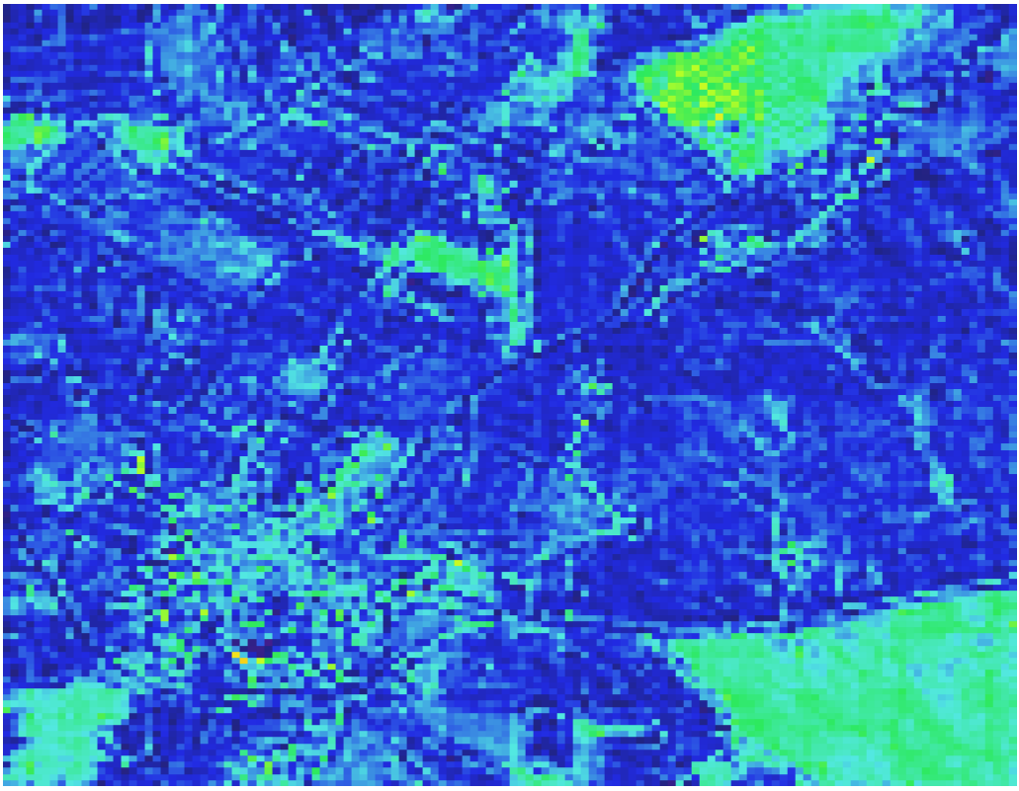
Site 28 MJJ21
Timestep 5
Timestep 10
Timestep 15
Timestep 20

Slide 13
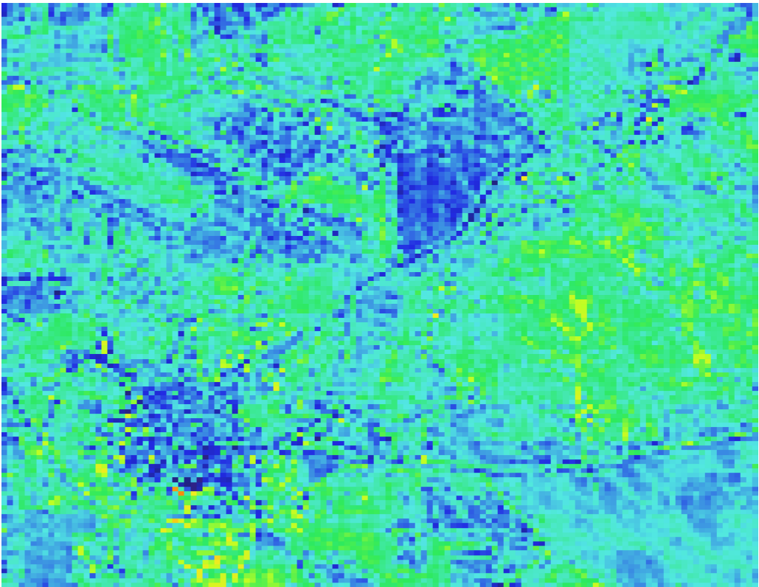
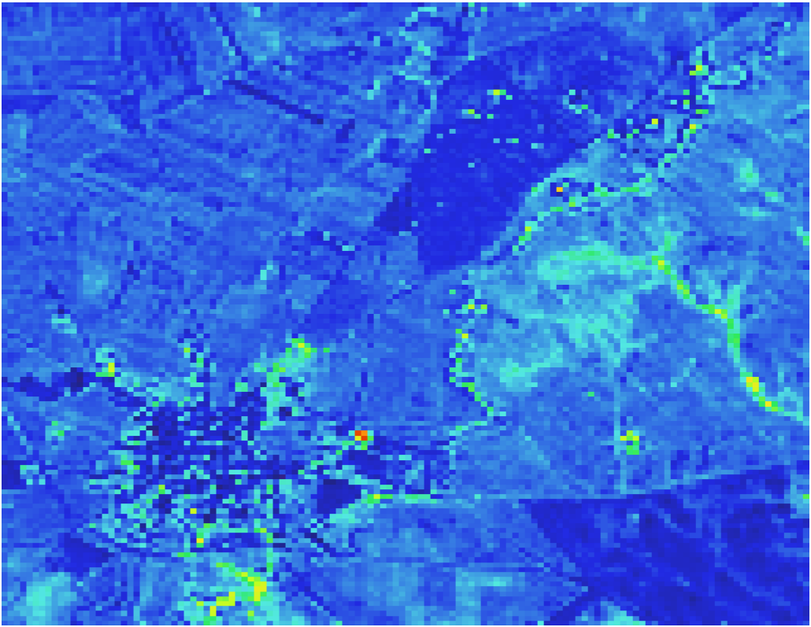
Site 28 Transition
MJJ21 Timestep 13 (equivalent to JAS21 Timestep 1)
MJJ21 Timestep 10
JAS21 Timestep 1

Slide 14
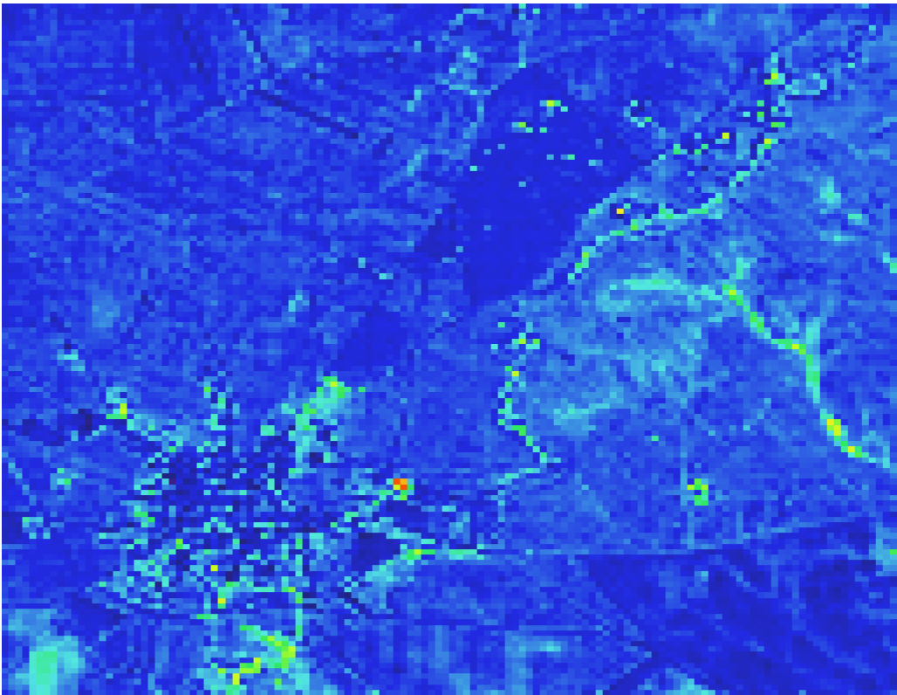
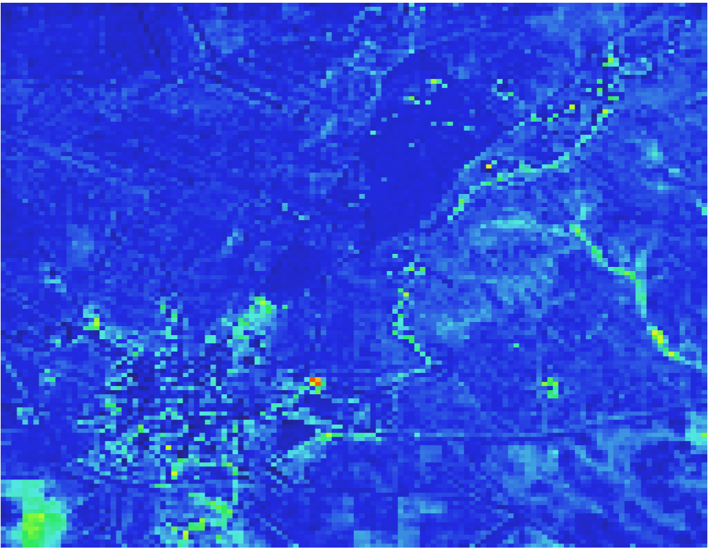
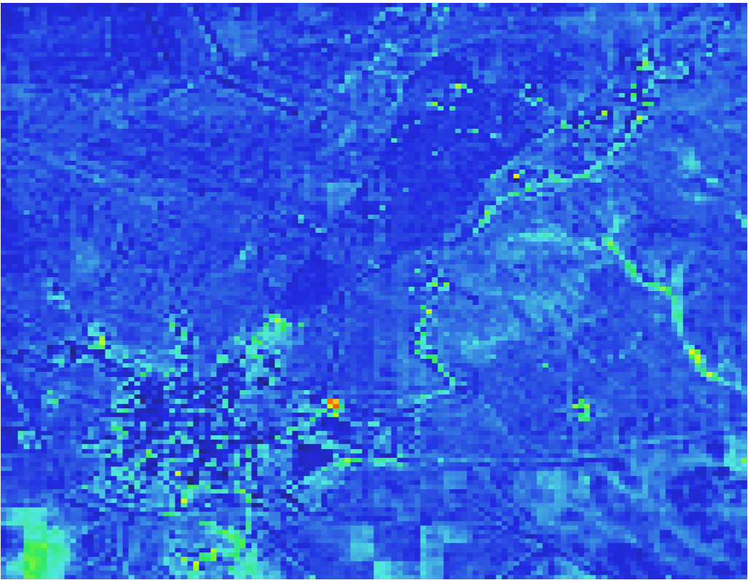
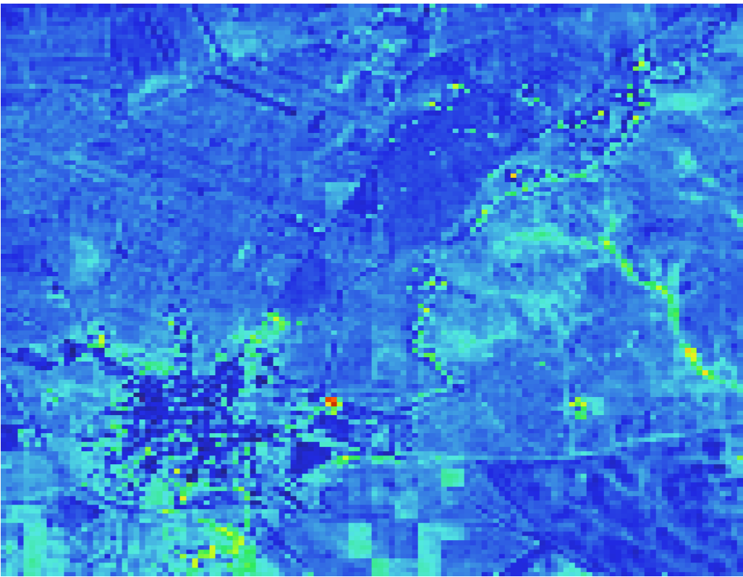
Site 28 JAS21
Timestep 3 (equivalent to MJJ21 Timestep 15)
Timestep 8
Timestep 13
Timestep 18

Slide 15
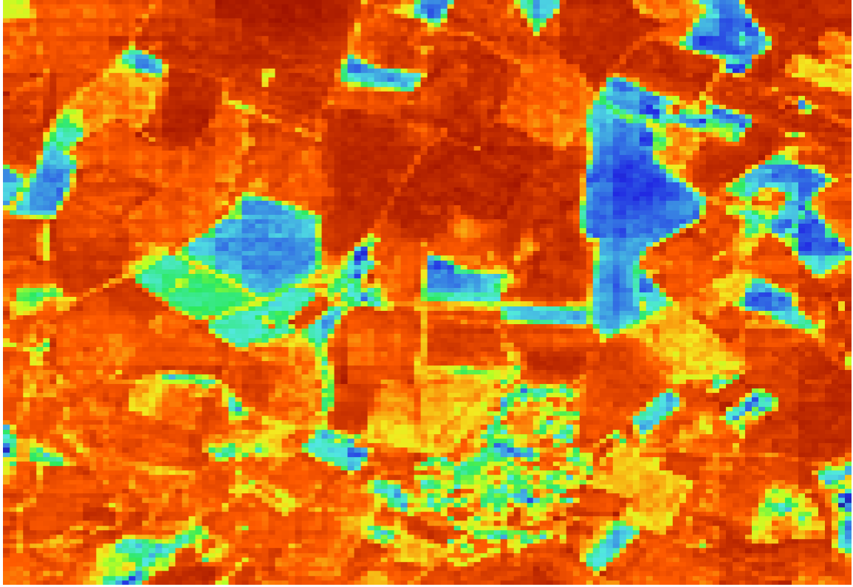
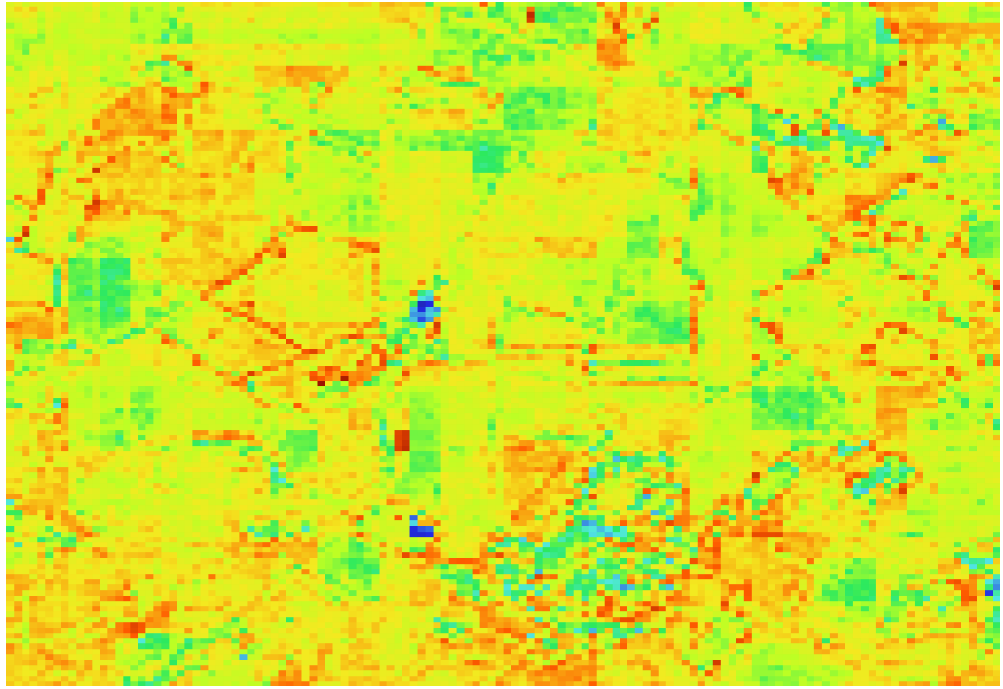
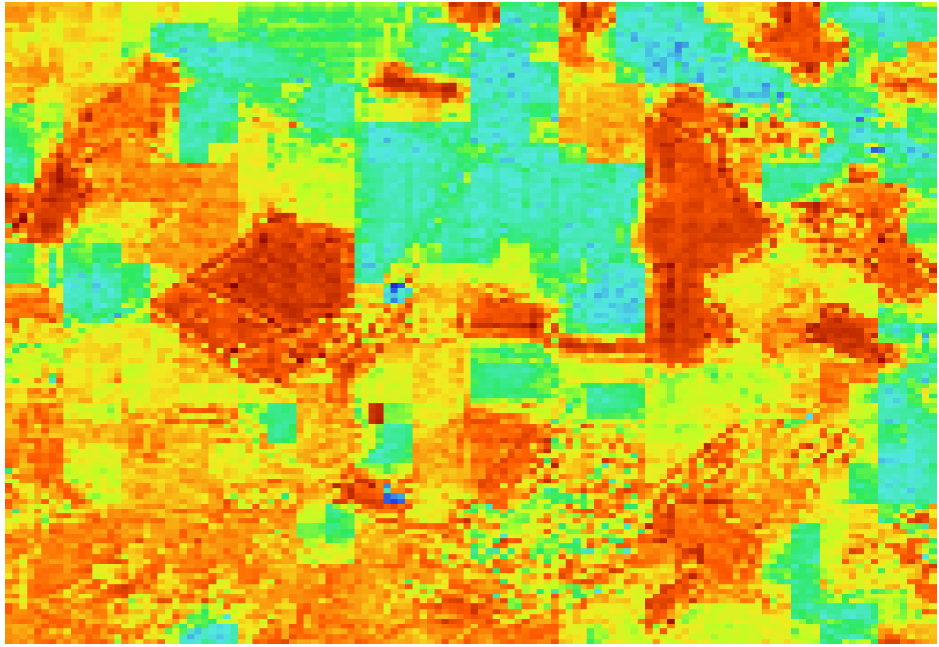
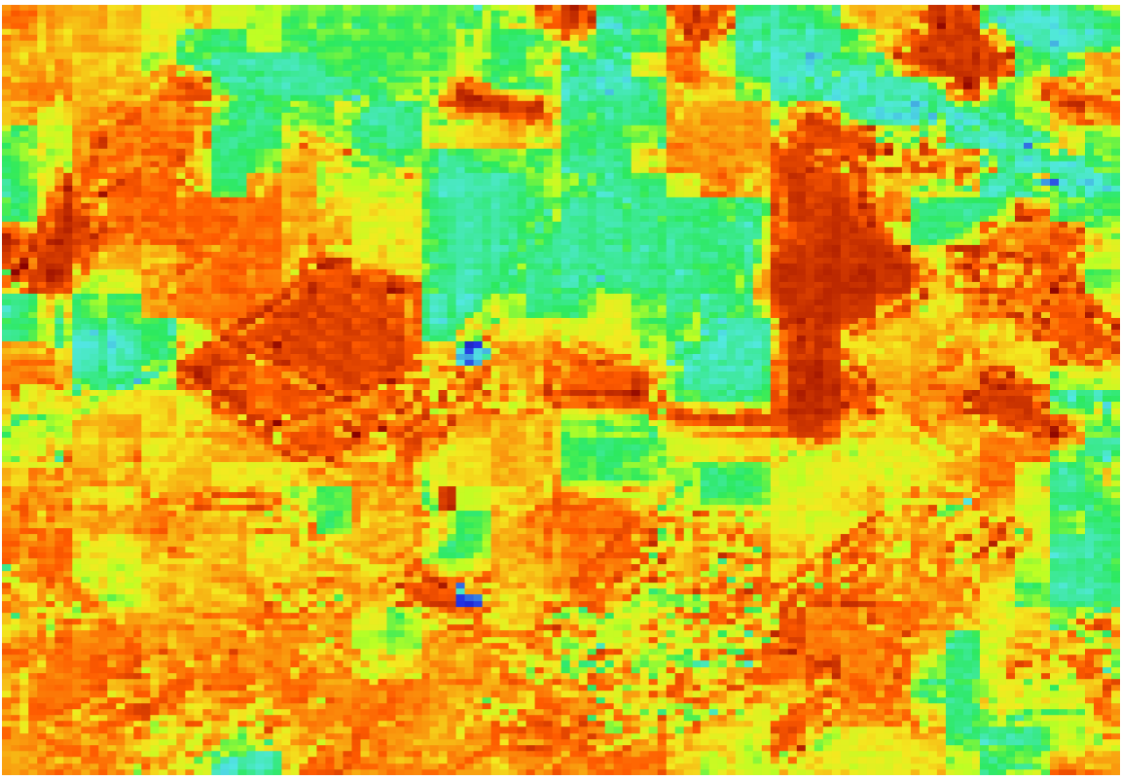
Site 36 MJJ21
Timestep 5
Timestep 10
Timestep 15
Timestep 20

Slide 16
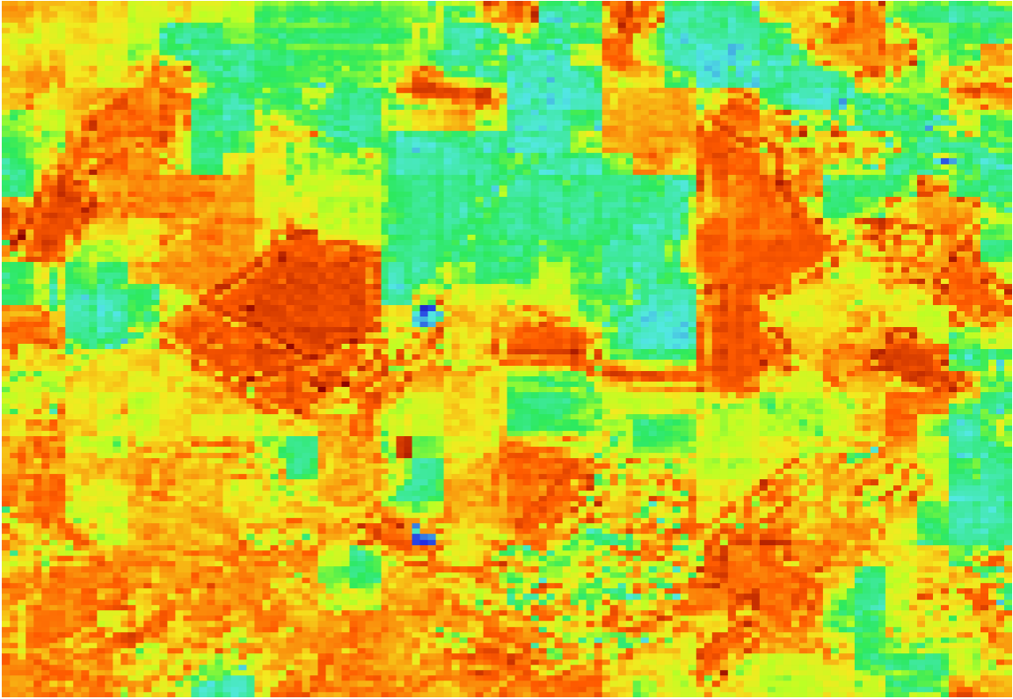
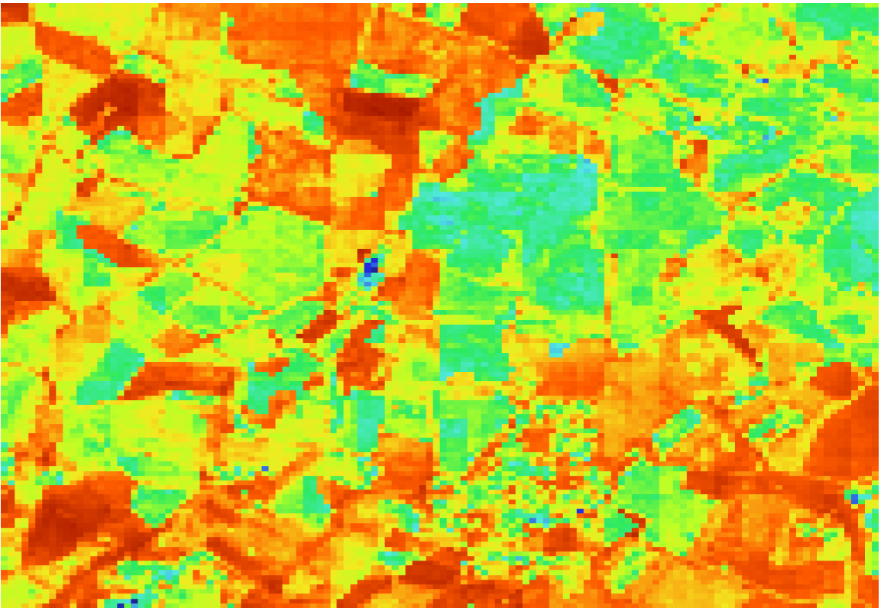
Site 36 Transition
MJJ21 Timestep 13 (equivalent to JAS21 Timestep 1)
MJJ21 Timestep 10
JAS21 Timestep 1

Slide 17




Site 36 JAS21
Timestep 5
Timestep 10
Timestep 15
Timestep 20

Slide 18




Site 38 MJJ21
Timestep 5
Timestep 10
Timestep 15
Timestep 20

Slide 19


Site 38 Transition
MJJ21 Timestep 13 (equivalent to JAS21 Timestep 1)
MJJ21 Timestep 10
JAS21 Timestep 1

Slide 20




Site 38 JAS21
Timestep 5
Timestep 10
Timestep 15
Timestep 20

Slide 21




Site 57 MJJ21
Timestep 5
Timestep 10
Timestep 15
Timestep 20

Slide 22


Site 57 Transition
MJJ21 Timestep 13 (equivalent to JAS21 Timestep 1)
MJJ21 Timestep 10
JAS21 Timestep 1

Slide 23




Site 57 JAS21
Timestep 5
Timestep 10
Timestep 15
Timestep 20

Slide 24




Site 83 MJJ21
Timestep 5
Timestep 10
Timestep 14
Timestep 20

Slide 25

Site 83 Transition
MJJ21 Timestep 14 (equivalent to JAS21 Timestep 2)
JAS21 Timestep 2

Slide 26




Site 83 JAS21
Timestep 5
Timestep 10
Timestep 14
Timestep 20

Slide 27




Site 124 MJJ21
Timestep 5
Timestep 10
Timestep 15
Timestep 20

Slide 28


Site 124 Transition
MJJ21 Timestep 13 (equivalent to JAS21 Timestep 1)
MJJ21 Timestep 10
JAS21 Timestep 1

Slide 29




Site 124 JAS21
Timestep 5
Timestep 10
Timestep 15
Timestep 20

Slide 30




Site 170 MJJ21
Timestep 5
Timestep 10
Timestep 15
Timestep 20

Slide 31


Site 170 Transition
MJJ21 Timestep 13 (equivalent to JAS21 Timestep 1)
MJJ21 Timestep 10
JAS21 Timestep 1

Slide 32




Site 170 JAS21
Timestep 5
Timestep 10
Timestep 15
Timestep 20

Slide 33




Site 238 MJJ21
Timestep 5
Timestep 10
Timestep 15
Timestep 20

Slide 34


Site 238 Transition
MJJ21 Timestep 13 (equivalent to JAS21 Timestep 1)
MJJ21 Timestep 10
JAS21 Timestep 1

Slide 35




Site 238 JAS21
Timestep 5
Timestep 10
Timestep 15
Timestep 20

